Slide 1
Assignment 4: PEFT and Multi-output Learning
2025 CGU Natural Language Processing and Applications
Ying-Jia Lin
Date: 2025/05/05

Slide 2
作業4 實作目標
希望同學：
學會基於 Hugging Face 物件建立新的模型
學會使用 Hugging Face PEFT
複習 PyTorch Dataset 與訓練流程
禁止項目：使用 Trainer

Slide 3
作業4 任務敘述
You are going to use the SemEval 2014 Task 1 dataset, where each data point is associated with multiple labels.
Therefore, you will need to build a model for multi-output learning.

Slide 4
Multi-output Learning
Objective1
Objective2
Objective1
Objective2
Multi-output Learning^{[1]}
Multi-task Learning^{[1]}
labels1
labels2
labels1
labels2
data
data1
data2
[1] Xu, Donna, et al. "Survey on multi-output learning." IEEE transactions on neural networks and learning systems 31.7 (2019): 2409-2429.

Slide 5
Dataset examples (SemEval 2014)
'0': NEUTRAL
'1': ENTAILMENT
'2': CONTRADICTION
*Answer in red
Value: 1-5
sub-task1 sub-task2
regression 3-class classification
premise | hypothesis | relatedness_score | entailment_judgement
A group of kids is playing in a yard and an old man is standing in the background | A group of boys in a yard is playing and a man is standing in the background | 4.5 | 0
A man, a woman and two girls are walking on the beach | A group of people is on a beach | 4.300000190734863 | 1
[1] SemEval-2014 Task 1: Evaluation of Compositional Distributional Semantic Models on Full Sentences through Semantic Relatedness and Textual Entailment, SemEval 2014

Slide 6
Dataset Introduction
*SemEval 2014 Task1 dataset
Train split: 4500 筆
Validation split: 500 筆
Test split: 4927 pieces
Each data piece: A premise, a hypothesis, a relatedness_score, an entailment_judgement
[1] SemEval-2014 Task 1: Evaluation of Compositional Distributional Semantic Models on Full Sentences through Semantic Relatedness and Textual Entailment, SemEval 2014

Slide 7
Code (hints only)

Slide 8
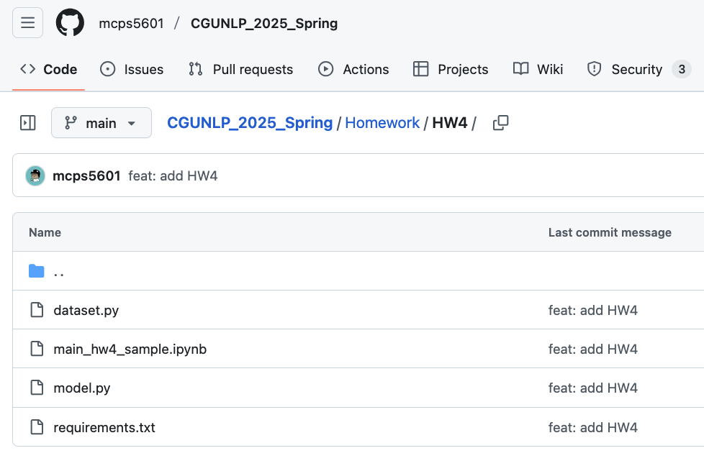
Homework 4 code hints
https://github.com/mcps5601/CGUNLP_2025_Spring/tree/main/Homework/HW4

Slide 9
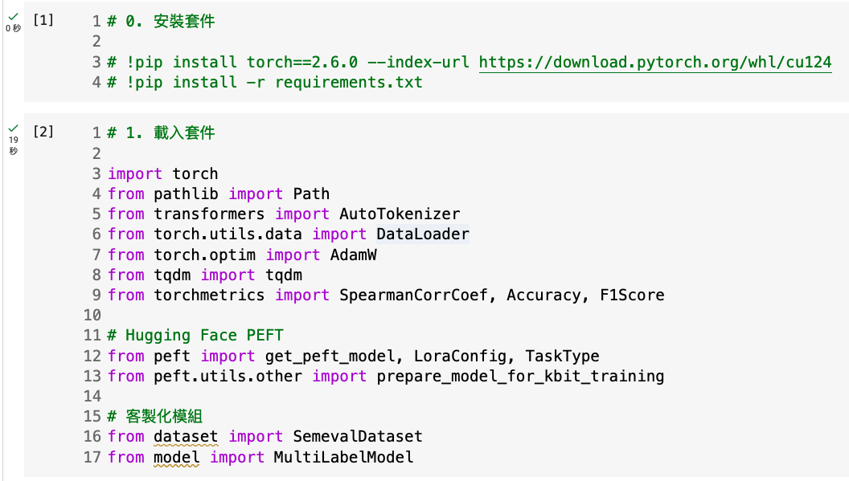
Install required packages

Slide 10
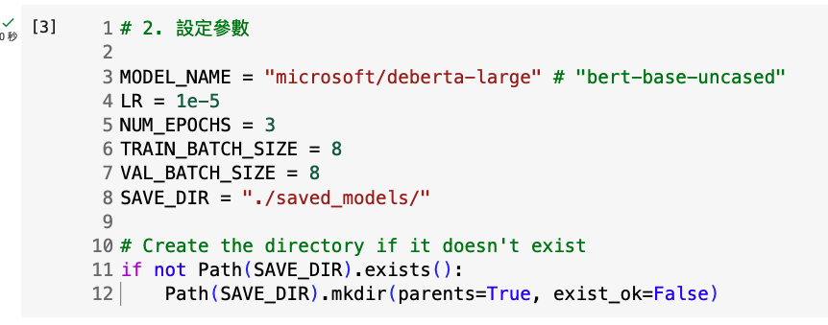
超參數

Slide 11
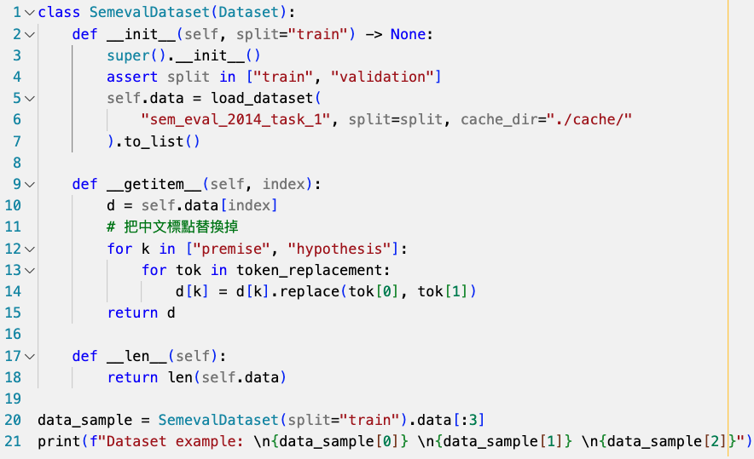
Load the dataset from Hugging Face
You need datasets==2.21.0 to download sem_eval_2014_task_1 from Hugging Face!
Observe the data instances

Slide 12
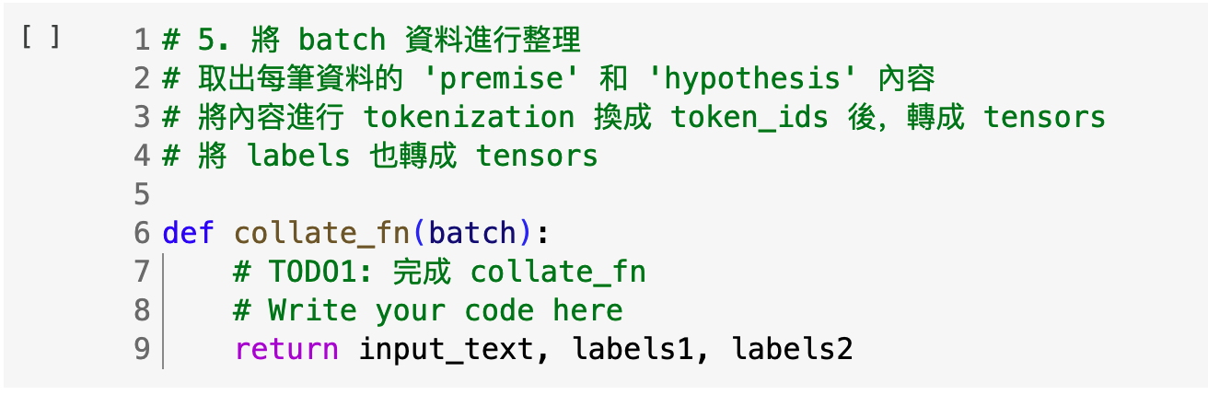
TODO1: 完成 collate_fn

Slide 13
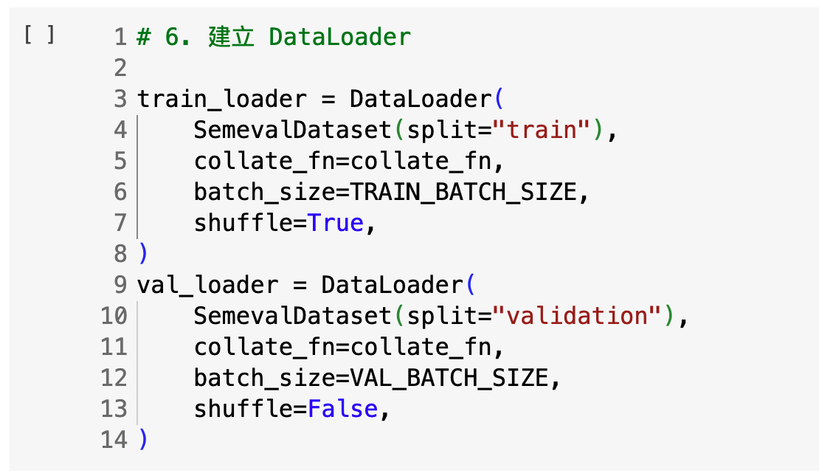
用 DataLoader 把資料分成 batches

Slide 14
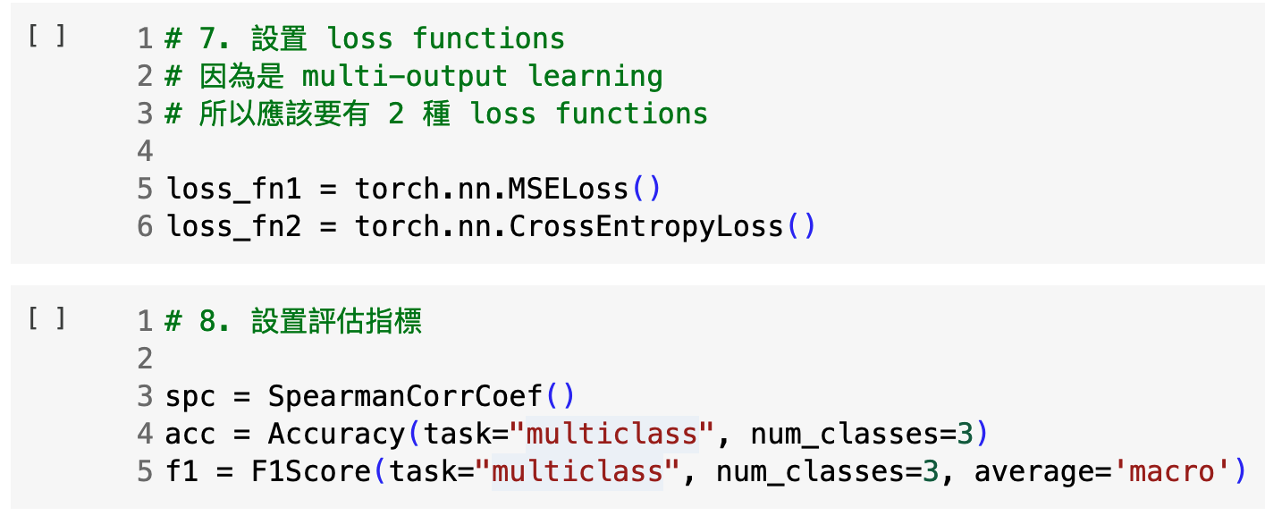
訓練前準備

Slide 15
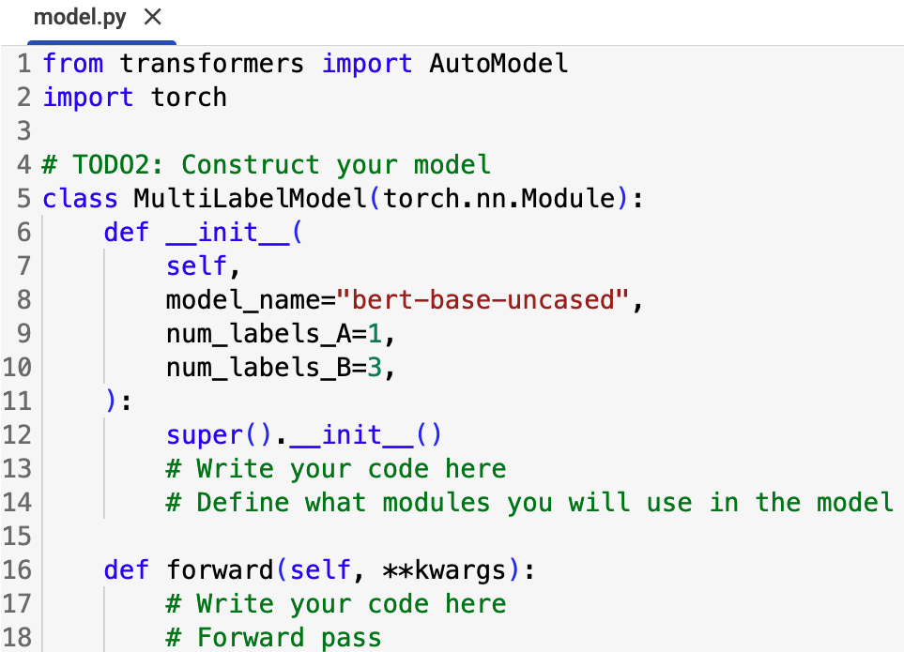
TODO2: Construct your model

Slide 16
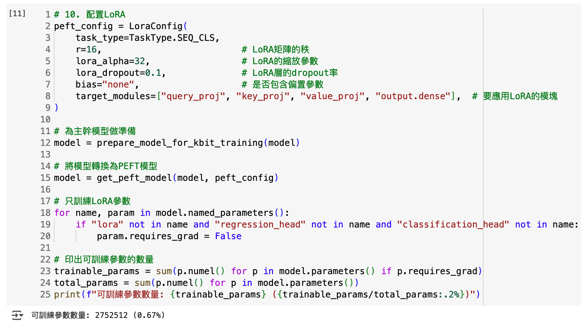
LoRA

Slide 17
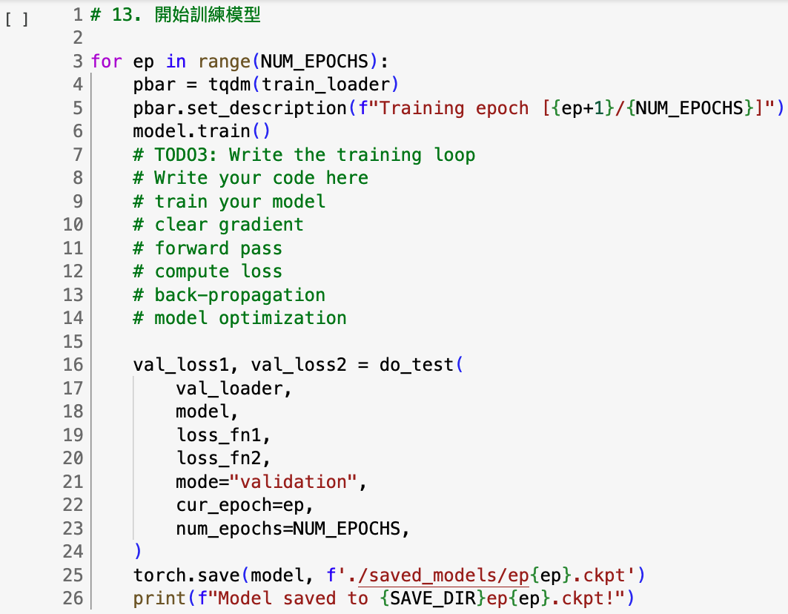
TODO3: Finish the training loop

Slide 18
TODOs
#TODO1 | 完成 collate_fn
#TODO2 | Construct your model
#TODO3 | Finish the training loop

Slide 19
Scoring
Coding work : 45% (15% for each of the three TODOs)
Baseline model performance (Accuracy) 0.70 on the validation set: 10%
Report: 55%
請簡要說明你使用了哪些模型與超參數設定 (10%)
不一定要用 DeBERTa
請至少跑一次 LoRA 和一次沒用 LoRA 的訓練，並說明你的結果 (10%)
請詳細說明你的 LoRA 設定 (10%)
目前sample code的做法是模型一次學兩種任務，請讓你的模型一次只在一種任務上訓練，並說明你的結果 (10%)
請試著嘗試加入更多LoraConfig的參數，並比較實驗結果差異 (10%)
… Anything that can strengthen your report. (5%)

Slide 20
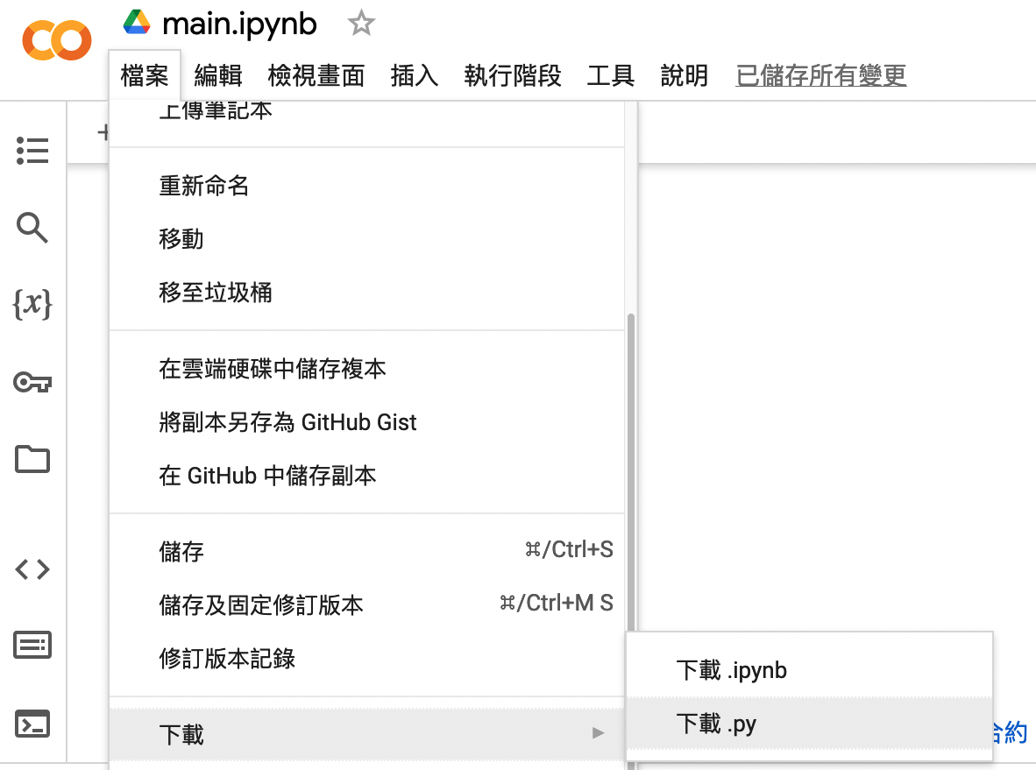
Delivery policies: File formats
Coding work: Python file (.py)
Download your script via Colab.
Package list: requirements.txt
E.g., torch==2.4.0+cu124
Report: Microsoft Word (.docx)
No other formats are allowed.
Zip the files above before uploading you assignment.

Slide 21
Delivery policies: Filenames
 | Filename rule | Filename example
Coding work | NLP_HW4_student_ID.py | NLP_HW4_12345678.py
Report | NLP_HW4_student_ID.docx | NLP_HW4_12345678.docx
Package list | requirements.txt
Zipped file | NLP_HW4_student_ID.zip | NLP_HW4_12345678.zip

Slide 22
Delivery policies: Things You should include
In your report:
 | Example
Environment types | If Colab or Kubeflow | If local
Running environment | Colab or Kubeflow | System: Ubuntu 22.04, CPU: Ryzen 7-7800X3D
Python version | Colab or Kubeflow | Python 3.10.1

Slide 23
Delivery policies: Rules of coding
If you use ChatGPT or Generative AI, please specify your usage both in:
Code comments
Reports
No plagiarism. You should not copy and paste from your classmates.
Please provide links if you take the code from the Internet as reference.
The following behaviors will cause loss in the score of the assignment: (1) Usage with Generative AI without specifications (2) Internet sources without specifications (3) Plagiarism.

Slide 24
Uploading the zipped file
Please upload your file to Teams.
You will have three weeks to finish this assignment.
Deadline: 2025/05/26 23:59
Feel free to ask questions

